Slide 1
Maintaining Success
Thursday, August 9, 2018
Ben Boyles
Clemson Extension

Slide 2
About Me!
Clemson Extension Agribusiness Agent
Administrator of the
South Carolina
Ag + Art Tour
Board Member,
South Carolina Agritourism Association
Board Member,
Catawba Farm and Food Coalition

Slide 3
How do you
define Success?

Slide 4
Maintaining Success
Know your Brand
Know your Community
Know your Market
Know your Future

Slide 5
1. Know your Brand
What does Brand
mean to you?

Slide 6
1. Know your Brand
Put simply, your “brand” is what your prospective customer thinks of when he or she hears your farm name

Slide 7

1. Know your Brand

Slide 8

1. Know your Brand

Slide 9

1. Know your Brand

Slide 10

1. Know your Brand

Slide 11

1. Know your Brand

Slide 12










1. Know your Brand

Slide 13

1. Know your Brand
Building a brand…
  Visual identity
  Advertising/Marketing
  Word of mouth
  Track record
  Consistent experience

Slide 14
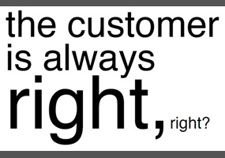
1. Know your Brand
Customer Experience Focus
  Ready
  Reliable
  Responsive
  Relationship-driven
Reputation

Slide 15
2. Know your Community
Regulators
Promoters
Service Providers
Decision Makers
Competition
Associations/Non-Profits/Agencies
Educators
Agritourism
Ecosystem

Slide 16
2. Know your Community
Tourism Partners
  Local
    CVBs, Tourism Offices, Chambers of Commerce, Economic Development, Agritourism Operators
  Regional
    State Tourism Districts, Non-Profits, COGs
  Statewide
    SCDA, Clemson, SCPRT, Farm Bureau

Slide 17

2. Know your Community
Be Engaged
  Leadership Development Programs
  Service Clubs
  School District
  Restaurants/Chefs
  Co-opetition

Slide 18
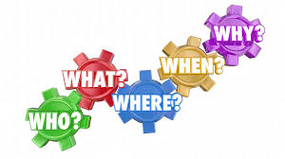
3. Know your Market
Know your Customer…

Slide 19
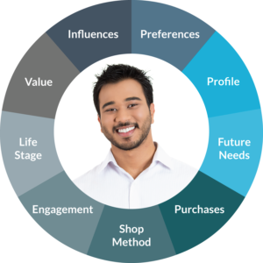
3. Know your Market
2018 Ag + Art Tour Customer Profile/Habits
    Website
      14,000 Users
      65% mobile device
    Social Media
      Age Range: 25-44
      72% Women
      Most active day: Sunday
    E-mail Marketing
      25.3 % open rate overall
      (Industry Average is 24.71%)
      4% click thru rate (Industry Average is 2.98%)
      60% opened on their mobile device

Slide 20


4. Know your Future
Evaluate your Operation
  Advertising Performance
  Activity Performance
  Employee Performance
  Owner Performance
Strategic Planning
  Re-evaluate business and marketing plans

Slide 21

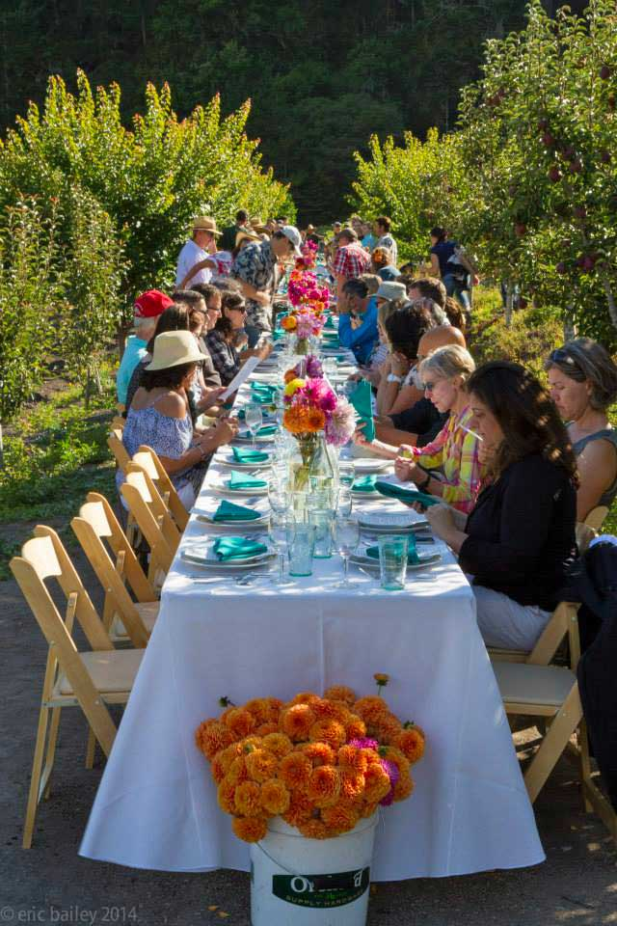
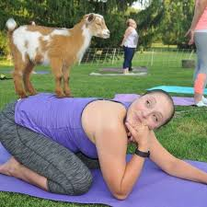
4. Know your Future
Try something new!
  Goat Yoga
  On-Farm Dinners
  Summer Camps
  Film Industry
  Farm Stays

Slide 22
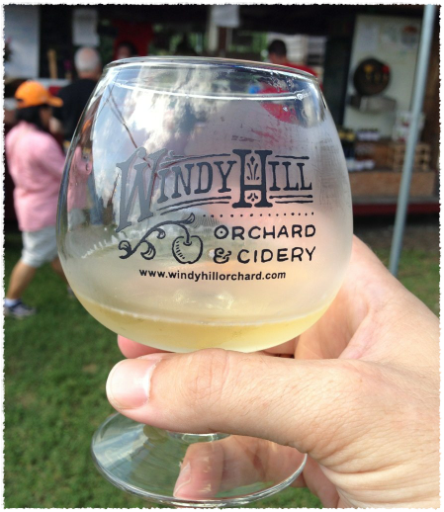
Agritourism Cheers!
Ben Boyles
boyles2@clemson.edu
803-981-3021

